Slide 1


Development Team
Project Owner
Smart Image Identifier

Slide 2
Requirements Specifications
Quality Requirements
Function Requirements
Critical:
Performance
Scalability
Integratibility
Auditability
Nice-to-have:
Flexibility
Maintainability
Reliability
Process images with human detection software
Audit Tracking

Slide 3
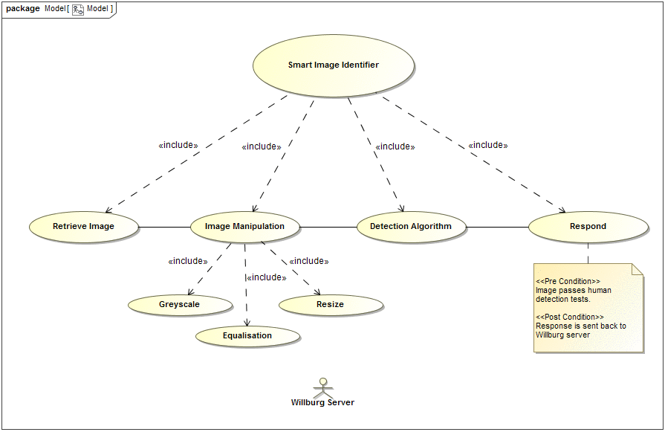
Smart Image Identifier

Slide 4
System Performance
Each image is processed 3 times totaling a time of under 3 seconds.
Average time per process: -+ 0.67 seconds.
The time is dependent on the test, gray-scaled images are easier to process as there is less information to process per pixel.

